Slide 1
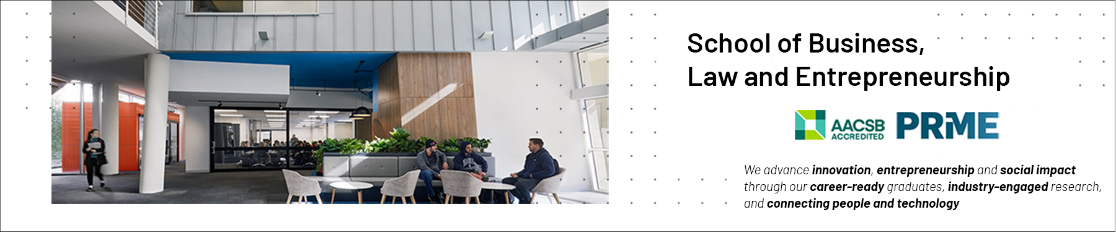

Teamwork as a Core Professional Competency Presentation 3: Group Structure and Leadership
Professional Capabilities for a Digital World

Slide 2
What is Group Structure?
Norms: what behaviour does the group demand?
Roles: what part do different group members play?
Relations: what are the relationships that bind group members to each other?
Notes:
Group Structure
If you wanted to look at only one aspect of group dynamics, the one aspect you would learn the most from would be group structure.
The norms of the group, who is in the group, the interdependence of the group.
So what is the group structure?
It is the arrangement and relationships of the individual elements of a system – it ties together the various components in a stable relationship.
It regulates the members.
The structure of a cohesive group would tend to minimise incompatibilities, inconsistencies amongst members.
Increases durability and the capacity of the group. All systems have structures – a building is a structure if there are parts that are inconsistent this will threaten the integrity of structure.
There are three aspects of a groups structure you need to be aware of:
Norms
Roles and,
Relations.
Norms are what the group defines as expected as normal – some norms are more important than others.
Norms are simply the group standards – they provide direction and motivation to group members – they are consensual – they are shared and help determine how the group functions.
Usually implicit and agreed but becomes an issue when someone breaks the norms.
New group members have to conform to these norms and inducting a new group member to these norms takes time and effort.
Roles are the part group members play in the group – they explain the different types of roles people play.
Different members play different roles and whilst this presents with diversity in individual groups we see these roles again and again across groups – so there are specific functions within groups that are discernible.
That role has expectations and you must produce in that role or risk sanction.
The third aspect is inter-member relations which links one member of a group to another.
And this is quite critical especially in terms of what that relationship is based on – attraction – who likes who. It might be based on influence – who tells who to do what.

Slide 3
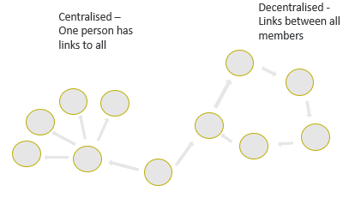
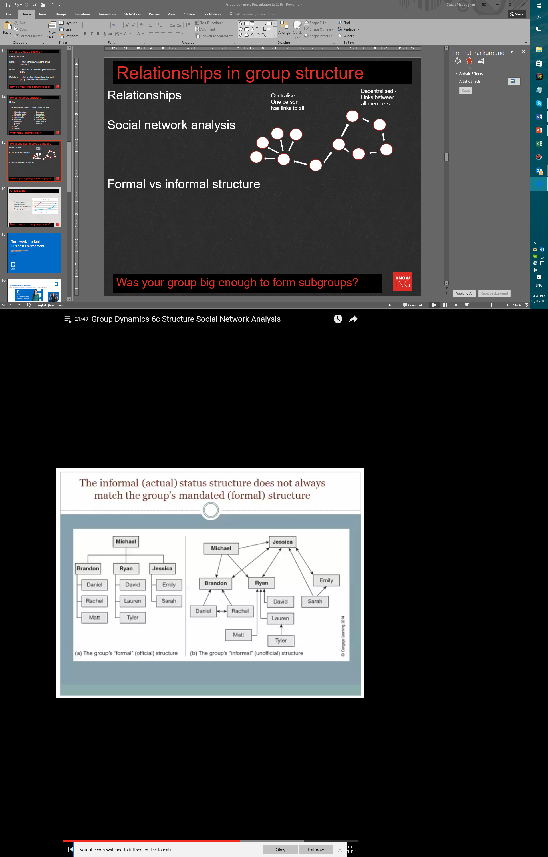
Relationships in group structures
Social network analysis
Formal vs informal structure
Notes:
Relationships in a group
Basically asking the question how are people in a group connected to each other. Research into this question is often based on social network theory which maps the relationships between people. Often subgroups form within groups and have an important effect on the dynamics of the group
Groups take all sorts of shapes. Subgroups are primarily divided into centralised and decentralised subgroups so here is an example. – diagram
Informal status structure can differ from the official structure.
Structure that is reflected on the official org chart of the organisation can differ in real terms.
Here we have an official structure with reports… yet the reality of the situation may differ. In this scenario Jessica is the most influential in the group.
Michael may influence Jessica but she is clearly at the centre of the groups communication network and influences the group more as does Ryan.

Slide 4
Leadership in Groups
Leadership
Reciprocal
Transactional
Transformational
Cooperative
Adaptive
Goal seeking
Leadership is power with people rather than over people
We can define leadership as the organising, directing, coordinating, supporting and motivation of others in pursuit of a common goal or goals.
How do you experience leadership in your group?
Notes:
Leadership
Not many people realise that the key to understanding the concept of leadership lies in understanding groups.
Leadership works in small groups. Leadership is power with people rather than over people.
To be an effective leader you have to understand group dynamics. The way I always put it is that you could have the vision to go somewhere, have the vision and drive to get there but if you cannot take people with you, you are not going to get there.
Leaders work in collaboration with others. Leaders are not born – they learn the skills of leadership over time.
This concept of leadership is especially relevant in small groups.
Leadership within small groups can often be distributed throughout the group – i.e. the functions of leadership are distributed throughout the group.
But research tells us that most people prefer to work in groups where the roles of leadership are clearly defined.
So what is leadership?
We can define leadership as the organising, directing, coordinating, supporting and motivation of others in pursuit of a common goal or goals.
And there are several things we need to be aware in terms of leadership:
It is reciprocal – you cannot have a leader without followers
It can be transactional – an exchange based process where the leader provides services with the followers addressing the leader’s needs.
Leadership is often described as transformational – it is often expected that leadership will transform group members – by increasing member satisfaction etc.
Leadership is a cooperative endeavour – facilitates the attainment of both the leader’s objectives and the follower’s objectives.
It is adaptive and goal-seeking.
KEY TAKEAWEAY – IN ORDER TO BE AN EFFECTIVE LEADER YOU NEED TO UNDERSTAND GROUP DYNAMICS.

Slide 5
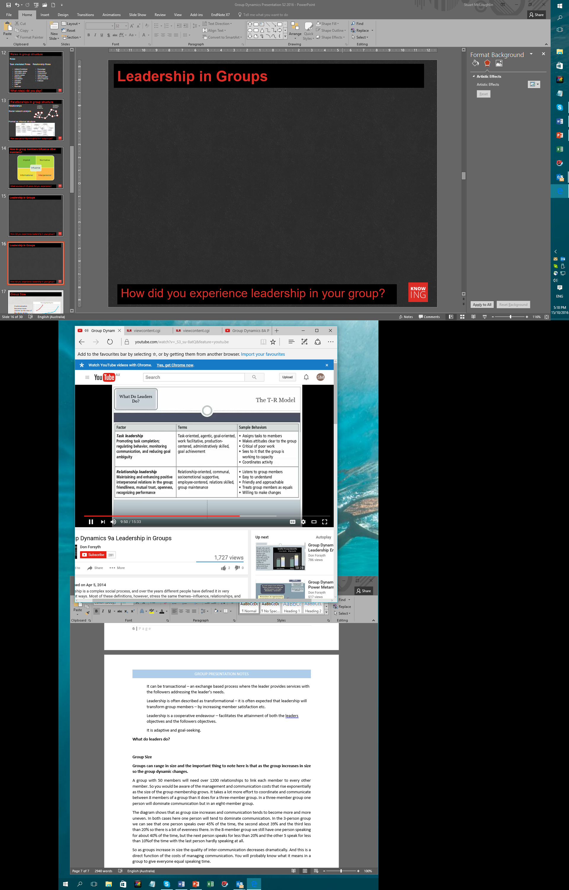
What do Leaders do?
Relational leadership and task leadership activities
How do you experience leadership in your group?
Notes:
What do Leaders do?
Go through slide.
People are more positively disposed towards relational leadership in the main whilst at the same time there is a gender bias towards male leadership. Somewhat confusing in that research shows females tend be stronger than males in terms of relational leadership. New research coming out shows effective groups are also a function of team composition – group function is affected by gender composition – in other words when the majority of the group is male and led by a female and vice versa.
And these findings reflect cross-culturally across the globe.
Social Identity theory adds the following:
Leaders must fit-in and reflect and shape the groups identity.
Effective leaders tend to minimise qualities that set them apart from the group.
Effective leaders strengthen group identity.

Slide 6
Group Performance
Steiner’s (1972) Theory of Process and Productivity
Actual productivity is equal to potential productivity less process loss.
Process loss:
Reduction in performance effectiveness or efficiency caused by actions, operations or dynamics that prevent the group from reaching its full potential, including reduced effort, faulty group processes, coordination problems and ineffective leadership
Notes:
Performance in Groups
People working in groups invariably have problems coordinating their efforts and making something happen but a great deal of the worlds work is achieved in groups. Performance or the quality of group outputs depends to a large extent on how well the individual group members can combine their individual contribution into a group contribution.
Process loss.
Groups tend to perform better than individuals. But this is not a given – procedures must be put in place to maximise their performance. There is a classic study on group process and productivity by Ivan Steiner that talks about the concept of process loss – which stipulates that performance effectiveness is reduced by the actions, operations and dynamics of that group that prevent it from achieving its full potential by –
Reduced effort
Faulty group processes
Coordination problems
Ineffective leadership.
The formula is: Actual productivity is equal to potential productivity less process loss.
And what Steiner is referring to is that as group workers try to work collectively there are factors in their group that work against that – it could be poor communication, it could be a key group member is absent, it could be task assignment goes wrong – tasks go to the wrong people. It could be that the leader does not coordinate effectively, does not pay attention to the relations between group members. So there are many factors that can cause productivity loss through process loss.
Let’s look more closely at one aspect of process loss that seems to affect students the most

Slide 7
Group Performance – Social Loafing
Process loss – Social Loafing
Ringelmann Effect
People become less productive when they work with others
That this loss of efficiency increases with group size
Two sources of process loss:
Coordination losses
Social loafing
Any experience of this?
Notes:
Social Loafing or free riding
what we refer to as the process of social loafing – the situation where one or more group members do not put all they can into the task – where individual members can hide a lack of contribution under the umbrella of diffused responsibility – where responsibility for the task is spread over the whole group.
This is known as the Ringelmann effect in honour of the person who first documented the fact. Which states that:
People become less productive when they work with others
That this loss of efficiency increases with group size
Ringelmann identified two types of process loss:
Firstly, coordination losses – as groups increase in size productivity efficiency is reduced due to coordination problems. Just think of 10 people carrying a log – there will be those putting maximum effort in and those who are barely contributing.
Secondly the issue of social loafing or free riding. Which tends to complicate coordination problems.

Slide 8
Group Performance – Social Loafing
Process loss – Social Loafing
Increase identifiability
Make the group as small as possible
Set clear, specific goals
Build in task interdependence
Increase identification with group
How do you deal with social loafing?
Notes:
Slide 24- Social Loafing – Dealing with the problem
So how do you deal with this? How do you try to maximise group output by reducing the position where people tend to coast along at the others expense?
Several options:
Increase identifiability – to make each individuals contribution to the group task known to others. Avoid the situation where everyone’s efforts are pooled with no distinct role definition amongst group members.
Minimise free-riding by making the group as small as possible. As groups grow in size so you are going to find more free riding.
Set clear specific goals – groups that are working towards clear goals tend to loaf a bit less. If those group goals can be associated with specific individual goals so the opportunity for free riding will be reduced.
You can increase engagement by building in task interdependence. Free riding is the worst where individuals can complete their tasks without a high level of collaboration. If you can link group member’s performance together so person A cannot complete their task until person B has completed their task, then this interdependence of tasks will serve to minimise free riding.
There is research which shows that if individuals strongly identify with their groups so free riding can be minimised. The object is to get individuals working for the group not just themselves.

Slide 9
Group Size
A group with 50 members will need over 1200 relationships to link each member to every other member
Communication becomes more uneven as the size of the group grows.
Does the size of the group matter?
Notes:
Group Size
Size is a very interesting phenomenon in group dynamics. Groups can range in size and the important thing to note here is that as the group increases in size so the group dynamic changes.
A group with 50 members will need over 1200 relationships to link each member to every other member. So you would be aware of the management and communication costs that rise exponentially as the size of the group membership grows. It takes a lot more effort to coordinate and communicate between 8 members of a group than it does for a three-member group.
The diagram shows that as group size increases and communication tends to become more and more uneven. In both cases here one person will tend to dominate communication. In the 3-person group we can see that one person speaks over 45% of the time, the second about 39% and the third less than 20% so there is a bit of evenness there.
In the 8-member group we still have one person speaking for about 40% of the time, but the next person speaks for less than 20% and the other 5 speak for less than 10% of the time with the last person hardly speaking at all.
In the 3 member group the person who contributed the least still contributed more than the second highest contributor in the 8 person group.
So as groups increase in size the quality of inter-communication decreases dramatically. And this is a direct function of the costs of managing communication. You will probably know what it means in a group to give everyone equal speaking time.

Slide 10
Key take-aways
Group Cohesion and Development
Decision-making within Teams
Group Leadership
Managing Conflict in Groups

Slide 11


